Slide 1

MFG 598 Engineering Computing with Python
Project Title: USED CAR PRICE PREDICTION
Sundeep Yalamanchili
1225760640

Slide 2

Problem: Forecasting the price of used cars based on different attributes.
Image Reference: https://www.google.com/search?q=used+car+prediction+ML&rlz=1C1CHBF_enIN978IN978&sxsrf=ALi

Slide 3
Objective: We will demonstrate and develop a model that can forecast the accurate price of used cars using a price prediction system that predicts the price on different parameters by using Machine Learning Algorithms and Data collected from the website.

Slide 4
Methodology:
Training Data
Model
Prediction
Testing

Slide 5
Training: Using the dataset's data, the system is taught to fit a model (a line or a curve) based on the algorithm.
Model A
Training
Dataset
Model B
Training
Model C

Slide 6
Inputs Fed
Functionality Check
Precision Examined
System employ proper Algorithm
Forecasting
Testing:

Slide 7
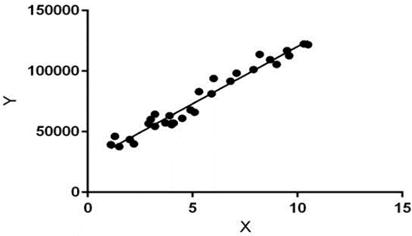

Existing System: Linear Regression
Hypothesis function for Linear Regression

Slide 8
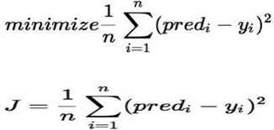
COST FUNCTION (J):

Slide 9
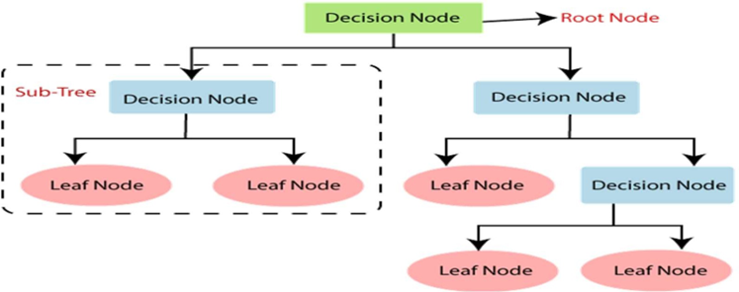
Decision Tree:

Slide 10
Disadvantages of Existing System:
Time Consuming
More difficult than other Algorithms
Random Forest Algorithm might be able to address the overfitting issue.

Slide 11
Proposed System
RANDOM FOREST MODEL: A random forest is a type of classifier that takes the average of a group of decision trees over various subsets of a given dataset to increase the dataset's predictive accuracy.

Slide 12
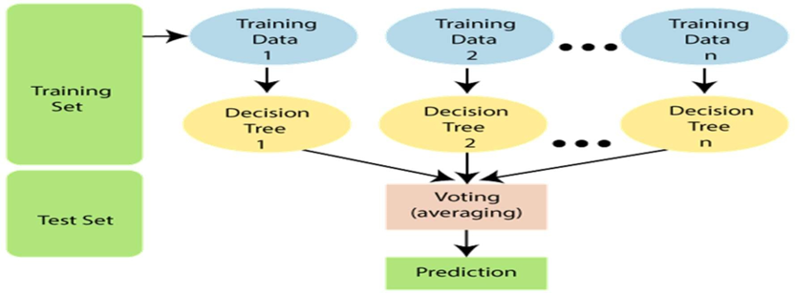
Random Forest Model

Slide 13
Advantages
1. It lessens decision trees' overfitting and enhances accuracy.
2. Adaptable to situations involving regression and classification.
3. is effective with both continuous and categorical values.
Automate data missing values.
5. To find a solution, it is necessary to compile various decision trees.

Slide 14
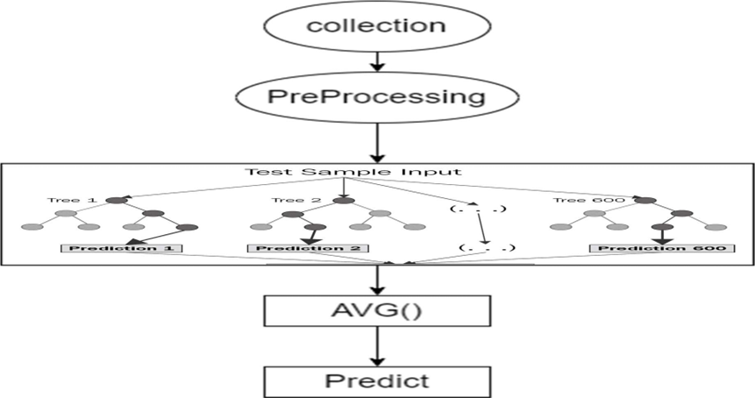
System Design

Slide 15
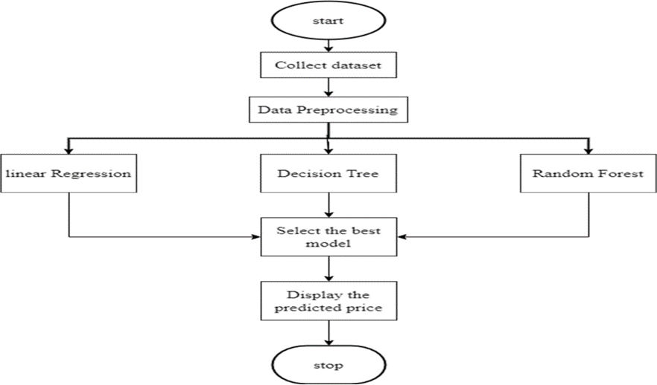
Data Flow

Slide 16
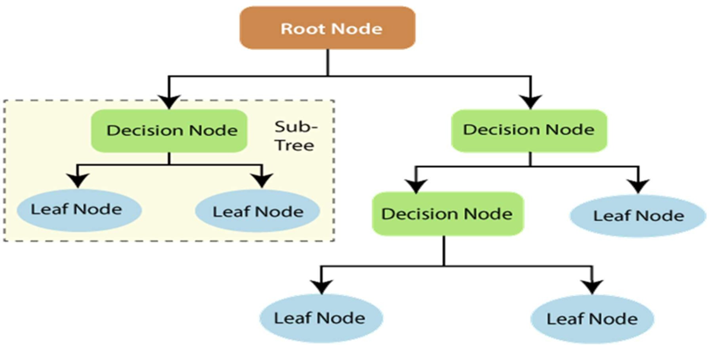

Slide 17
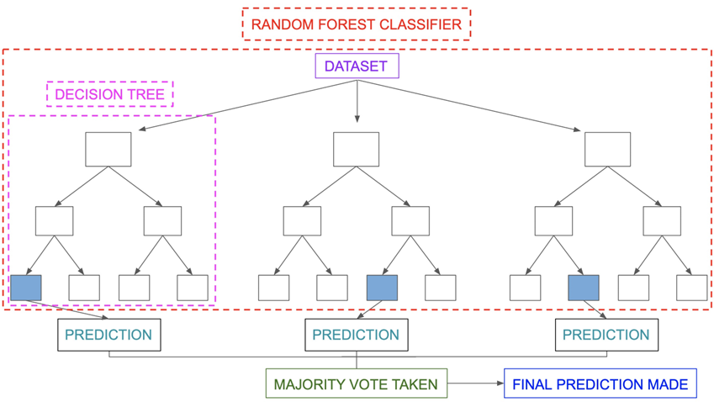
Random Forest Classifier

Slide 18
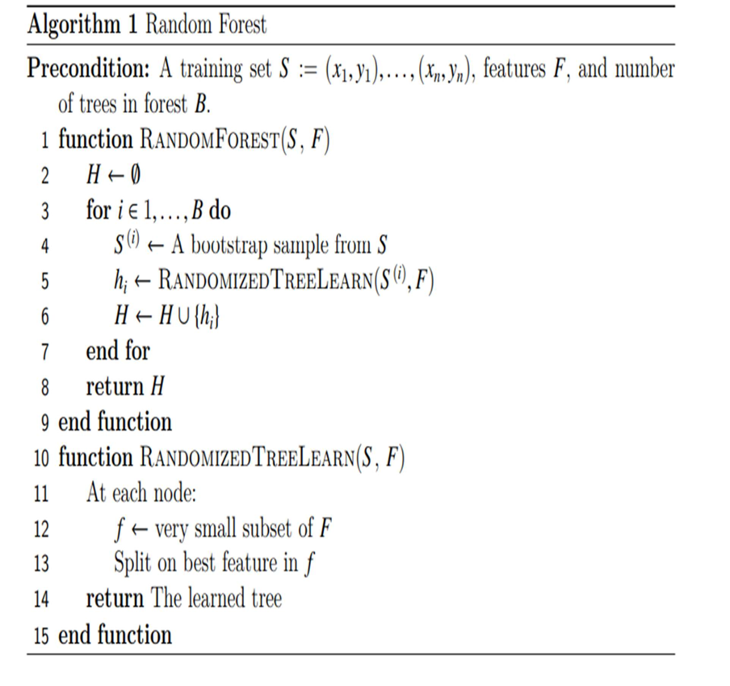

Slide 19
System Implementation
PACKAGES
In our project we are using the following libraries in python.
Numpy
Pandas
Seaborn
Matplotlib
Sklearn

Slide 20
Modules:
Acquiring the dataset
Data Processing
Data Visualization
Pre Modeling
Choosing the best fit

Slide 21
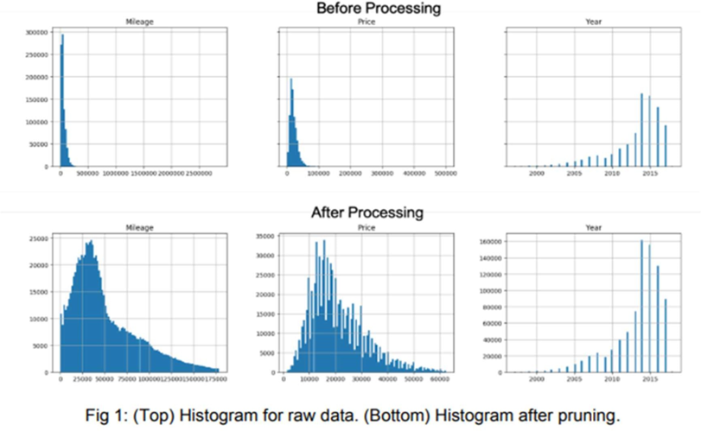
Data Processing

Slide 22
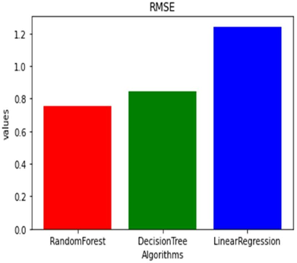
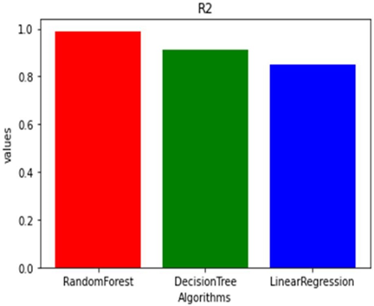

Slide 23

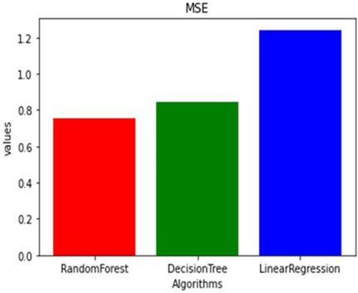

Slide 24
Conclusion: As new car prices have soared and consumers can no longer afford them, used car sales are rising globally. Because of this, there is a critical need for a system that can accurately estimate the worth of a used car from various attributes. With the proposed (random forest) approach, it is possible to anticipate used car prices with greater accuracy.

Slide 25
Futurescope: Future connections between this machine learning model and several websites that offer real-time data for price prediction are possible. Large historical car price data can be added as well, which will assist the machine learning model's accuracy. As a user interface to communicate with the user, we can construct an Android application.

Slide 26
References:
1. https://www.kaggle.com/jpayne/852k-used-car-listings
2. N. Monburinon, P. Chertchom, T. Kaewkiriya, S. Rungpheung, S. Buya and P. Boonpou, "Prediction of prices for used car by using different models," 2018 5th International Conference on Business and Industrial
3. Research (ICBIR), Bangkok, 2018, pp. 115-119. 3.https://scikit-learn.org/stable/modules/classes.html: Scikit-learn: Machine Learning in Python,
Pedregosa et al., JMLR 12, pp. 2825-2830, 2011.
4. https://github.com/topics/car-price-prediction
5. DATASET: https://www.kaggle.com/nehalbirla/vehicle-dataset-from- cardekho?select=car+data.csv
6. Sameerchand Pudaruth, “Predicting the Price of Used Cars using Machine Learning Techniques” ;(IJICT 2014).
7. Ning sun, Hongxi Bai, Yuxia Geng, Huizhu Shi, “Price Evaluation Model in Second Hand Car
System Based on BP Neural Network Theory”; (Hohai University Changzhou, China).

Slide 27
Thank you!

